Slide 1


IPSP: An image processing and storage pipeline
Group 5
Vũ Hữu An
Lưu Thiện Việt Cường
Đàm Quang Đức
Lại Trí Dũng
Nguyễn Trọng Tâm
20225467
20225477
20225483
20225486
20225527
3

Slide 2

TABLE OF CONTENTS
I. ABOUT OUR PROBLEM
II. DATA INGESTION LAYER
III. STREAMING PROCESSING LAYER
IV. STORAGE LAYER
V. LESSON LEARN

Slide 3

I. ABOUT OUR PROBLEM

Slide 4

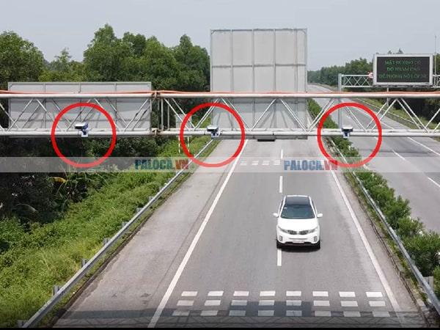
I. ABOUT OUR PROBLEM
I. OUR PROBLEM
Peak hour traffic causes severe urban congestion daily.
Real-time image data provides vital traffic insights.
→ Optimize routes to reduce total travel time.
→ Efficiently monitor flow using AI-driven analysis.

Slide 5







I. ABOUT OUR PROBLEM
Pre - processing
Storage
Ingestion
input
LMDB format
distributed storage
message queue
convert
store
produce
store
Batch Processing
Serving
model_training
consume
convert
metric_computing
store
visualization
nosql database
Stream Processing

Slide 6
II. DATA INGESTION LAYER

Slide 7
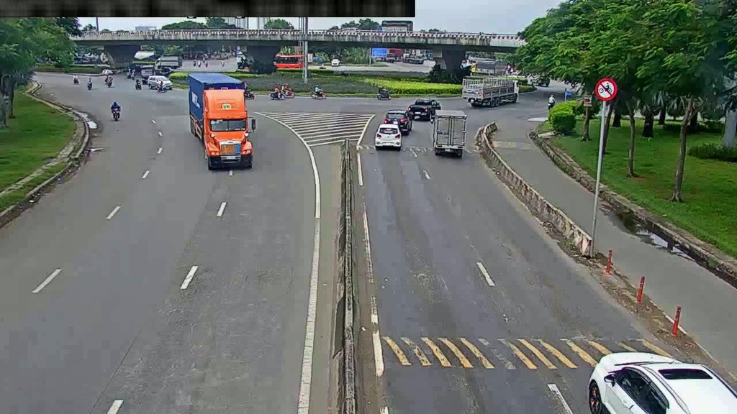
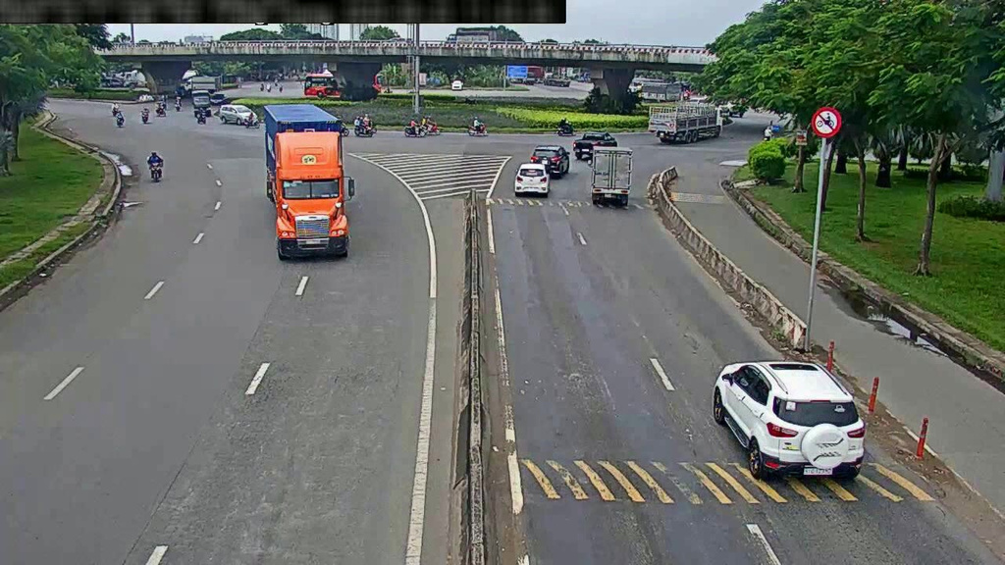
II. DATA INGESTION LAYER
1. Data Source
Competition dataset contains 10,000 images of 10 cameras.
Images include corresponding labels for object detection.

Slide 8
II. DATA INGESTION LAYER
2. Data Preprocessing
Data processed are converted to LMDB format.
LMDB format data are stored in Minio.
Key | Value
cam_01_00001 | FF D8 FF E0 00 10 4A 46 49 46 00 01 02 00 00 01
cam_01_00002 | FF D8 FF E0 00 10 4A 46 49 46 00 01 02 00 00 01
cam_01_00003 | FF D8 FF E0 00 10 4A 46 49 46 00 01 02 00 00 01

Slide 9
II. DATA INGESTION LAYER
3. Data Ingestion
Traffic Camera Producer
Simulates live traffic camera feeds
Reads serialized image data (LMDB).
Maps camera_id to specific Kafka partitions.
Sends binary/JSON payloads to Kafka topic: traffic_data.
Kafka Cluster
Deployed on Kubernetes using StatefulSets for persistence.
Configured with 10 partitions to match 10 camera streams.
Acts as a decoupling layer and backpressure buffer.

Slide 10
II. DATA INGESTION LAYER
4. Data Flow
Producers extract images and labels from LMDB and generate simulated real-time traffic events.
Incoming messages are buffered in the Kafka topic traffic_data using UTF-8 JSON for metadata and Base64/Binary for images.
Key-based Partitioning: Ensures all frames from a single camera always land in its corresponding partition.
{
"camera_id": "cam_01",
"timestamp": "2025-01-01T00:00:00Z",
"image_id": “cam_01_00001,
"image": base64 data,
"objects": [
{
"class_id": 3,
"bbox": [747, 188, 814, 276 ],
}
]
}

Slide 11
III. STREAM PROCESSING LAYER

Slide 12
III. STREAM PROCESSOR LAYER
1. Spark deployment
Deployment: Deployment with 1 replica.
Storage: Ephemeral (In-Memory RAM-based, no Persistent Volume).
Database Version: Official Redis Alpine image (Lightweight).
Service Strategy:
Internal: Port 6379 via redis-service (ClusterIP) for Spark Workers coordination and metadata caching.
Security: Default standalone mode (No password authentication configured in this manifest).

Slide 13
III. STREAM PROCESSOR LAYER
2. Output
🛢 traffic_db
📂realtime_monitor
🗐 Documents
“695a93315bf9592ba2af22e7"
________________________________________________
{"_id": {
"$oid": "695a93315bf9592ba2af22e7"
},
"camera_id": "cam_08",
"timestamp": "2026-01-04T16:19:24.890910",
"traffic_status": "NORMAL",
"density": 0.17829999327659607,
"alert_message": null,
"count_motorbike": 15, "count_car": 1,
"count_bus": 1, "count_container": 0,
"speed_motorbike": 0, "speed_car": 0,
"speed_bus": 0, "speed_container": 0}
Aggregates vehicle counts by classifying object IDs per frame.
Computes density ratio using total vehicle bounding box area.
Estimates average speed based on object displacement over time.
Determines traffic status by applying thresholds to calculated density.

Slide 14
IV. BATCH PROCESSING LAYER

Slide 15
IV. BATCH PROCESSING LAYER
1. Batch Processing - Model Training
Deployment: Kubernetes Deployment executing a Spark-based Dispatcher service with "Always" restart policy.
Resource Management: Requests 4Gi RAM / 1 vCPU; limits up to 8Gi RAM / 2 vCPU.
Execution Engine: Spark configured in local[*] mode (uses all available cores in the pod).

Slide 16
IV. BATCH PROCESSING LAYER
1. Batch Processing - Model Training
Integration Strategy:
Ingestion: Consumes raw traffic data from Kafka (traffic_data topic).
Processing: Prepares training data and coordinates logic via dispatcher_main.py.
Sink: Pushes training tasks to Kafka (training_jobs) for workers and interacts with MinIO for storage.

Slide 17
IV. BATCH PROCESSING LAYER
1. Batch Processing - Model Training (CPU Training)
Architecture
Single Spark batch training job running on Kubernetes
Spark handles both data processing and model training
Data Flow: MinIO (LMDB) → Producer → Kafka (traffic_data)
Training Execution: CPU training, batch size small due to memory.
Checkpointing & Output
Uploads model weights and logs after job completion
Job is manually triggered

Slide 18
IV. BATCH PROCESSING LAYER
1. Batch Processing - Model Training (GPU Training)
Architecture
Decoupled system: Producer → Dispatcher → GPU Worker
Spark used as job orchestrator, not trainer
Data Flow
MinIO (LMDB) → Producer → Kafka (traffic_data)
Training jobs published to Kafka (training_jobs)
Checkpointing & Output: Enables incremental and continuous training

Slide 19
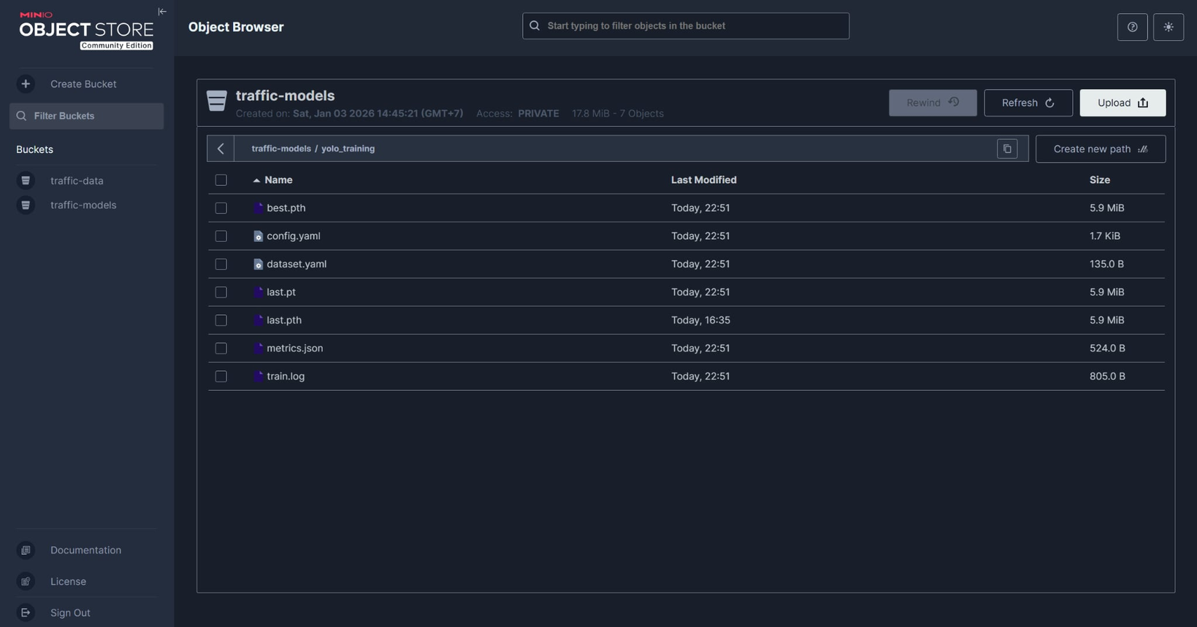
IV. BATCH PROCESSING LAYER
1. Batch Processing - Model Training

Slide 20
IV. BATCH PROCESSING LAYER
2. Batch Processing - Metric Computing
Deployment: Kubernetes Job executing a Spark submit task with "Never" restart policy.
Resource Management: Driver pod requests 1Gi RAM / 0.5 vCPU;
Executors run on Spark Workers (1 core, 512MB RAM per instance).
Execution Engine: Spark configured in Standalone Cluster mode (target: spark://spark-master:7077) using Client deploy mode.

Slide 21
IV. BATCH PROCESSING LAYER
2. Batch Processing - Metric Computing
Integration Strategy:
Ingestion: Consumes streaming/batch traffic data from Kafka (traffic_data topic).
Logic: Performs object detection (YOLOv8) with models dynamically loaded from MinIO.
Sink: Persists computed metrics into MongoDB and retrieves configuration assets from MinIO.

Slide 22
IV. BATCH PROCESSING LAYER
2. Batch Processing - Metric Computing
🛢 traffic_db
📂traffic_daily_summary
🗐 Documents
“695abb670c963501e2acee26"
________________________________________________{ "_id": {
"$oid": "695abb670c963501e2acee26"
},
"date": {
"$date": "2026-01-04T00:00:00Z"
},
"camera_id": "cam_01",
"total_vehicles_all_types": 321,
"avg_speed_day": 3.1079502611110357,
"peak_hour": 16.613055555557366,
"congestion_hours": 0.005}
2. 2. Output
Aggregates total daily vehicle volume across all distinct tracks.
Identifies peak traffic hours based on maximum density occurrences.
Calculates total duration of congestion throughout the day.
Computes overall average speed for daily performance benchmarking.

Slide 23
IV. BATCH PROCESSING LAYER
2. Batch Processing - Metric Computing
🛢 traffic_db
📂traffic_heatmaps
🗐 Documents
“695abb69728b5c8109b6918b"
________________________________________________{
"_id": {
"$oid": "695abb69728b5c8109b6918b"
},
"date": "2026-01-04",
"camera_id": "cam_01",
"heatmap_url":"http://myminio:9000/configs/reports/heatmaps/cam_01_20260104.png",
"description": "Heatmap"
}
2. 2. Output
Aggregates spatial coordinates of all vehicle tracks per day.
Generates 2D visual heatmaps representing distribution intensity.
Uploads generated image artifacts to MinIO object storage.
Records heatmap metadata and file URLs for dashboard rendering.

Slide 24
IV. BATCH PROCESSING LAYER
2. Batch Processing - Metric Computing
🛢 traffic_db
📂traffic_stats_1min
🗐 Documents
“695abb640c963501e2acecd9"
________________________________________________{ "_id": { "$oid": "695abb640c963501e2acecd9"},
"window_start": { "$date": "2026-01-04T16:19:30Z"},
"window_end": { "$date": "2026-01-04T16:20:30Z"},
"camera_id": "cam_01",
"unique_motorcycle_count": 19, "unique_car_count": 14,
"unique_bus_count": 11, "unique_truck_count": 27,
"avg_speed_motorcycle_kmh": 0.2027123085664291,
"avg_speed_car_kmh": 0.43831173862729755,
"avg_speed_bus_kmh": 0.6074128008701585,
"avg_speed_truck_kmh": 0.664223162940255,
"avg_density_pct": 3.8297903633299875}
2. 2. Output
Aggregates unique vehicle counts within sliding one-minute windows.
Calculates average speeds for specific vehicle classes per minute.
Computes average road density percentage for the time interval.
Merges flow, speed, and density into unified time-series records.

Slide 25
V. STORAGE LAYER

Slide 26
V. STORAGE LAYER
1. Minio
Deployment: StatefulSet with 1 replica.
Storage: 10Gi Persistent Volume.
Credentials: Root access configured with custom username/password.
Service Strategy:
API: Port 9000 (ClusterIP) for programmatic data ingestion (Producer/Spark).
Console: Port 9001 (ClusterIP) for browser-based object management.

Slide 27
V. STORAGE LAYER
1. Minio
Example Structure
/traffic_data/
├── models/
│ ├── rtdetr_traffic_best.pt
│ ├── yolov8_traffic_best.pt
│ ├── yolo11n_traffic_best.pt
├── raw_lmdb/
│ ├── cam_01.lmdb
│ ├── data.mdb
│ ├── lock.mdb
└ ├── cam_02.lmdb

Slide 28
V. STORAGE LAYER
2. MongoDB
Deployment: StatefulSet with 1 replica.
Storage: 5Gi Persistent Volume.
Database Version: Official Mongo 6.0 image.
Service Strategy:
Internal: Port 27017 (ClusterIP) for Spark Sink and Metabase connection.
Security: Root authentication enabled with predefined administrative credentials.

Slide 29
V. STORAGE LAYER
3. Redis
Deployment: Deployment with 1 replica.
Storage: Ephemeral (In-Memory RAM-based, no Persistent Volume).
Database Version: Official Redis Alpine image (Lightweight).
Service Strategy:
Internal: Port 6379 via redis-service (ClusterIP) for Spark Workers coordination and metadata caching.
Security: Default standalone mode (No password authentication configured in this manifest).

Slide 30
VI. LESSON LEARNED

Slide 31
VI. LESSON LEARNED
4.1. Lessons on Data Ingestion: Solving the "Small Files Problem" with LMDB
Context: The project ingests a dataset of 10,000 traffic images
Approach:
Approach 1. Raw File Iteration. Reading ‘.jpg‘ files directly from disk.
Approach 2. Binary Packing (LMDB). Consolidating images into a Key-Value Lightning Memory- Mapped Database.
Best Practice: Container formats leverage sequential reads, memory mapping.
4.2. Lessons on Data Processing: The "Distributed Overhead" Paradox
Context: Processing small datasets on a distributed cluster vs. local node.
Approach:
Approach 1. Horizontal Scaling. 35% slower by network coordination overhead.
Approach 2. Vertical Scaling. Faster processing with no network latency.
Best Practice: Avoid distributed systems for small data; monolithic is faster.

Slide 32
VI. LESSON LEARNED
4.3. Lessons on Stream Processing: Handling Late Data
Context: Aggregating traffic density with network jitter causing delays.
Approach:
Approach 1. Processing Time. Inaccurate results based on server clock.
Approach 2. Event Time. Accurate windowing using timestamps & Watermarking.
Best Practice: Always decouple Event Time from Processing Time.
4.4. Lessons on Data Storage: Hybrid Storage Strategy
Context: Storing both high-volume raw images and low-volume metrics.
Approach:
Approach 1. Single Store. Caused database bloat and slow performance.
Approach 2. Hybrid Store. Utilize MinIO, MongoDB, Redis.
Best Practice: Align storage engines with data access patterns (Polyglot Persistence).

Slide 33
VI. LESSON LEARNED
4.5. Lessons on System Integration: K8s Service Discovery
Context: Connecting components in dynamic Kubernetes pods.
Approach:
Approach 1. Hardcoded IPs. System fails immediately upon pod restarts.
Approach 2. Internal DNS. Robust connectivity via K8s Service names.
Best Practice: Never use Pod IPs; rely on Service DNS abstraction.
4.6. Lessons on Performance: Decoupling GPU Workloads
Context: Training models where Spark CPU tasks bottlenecked GPU speed.
Approach:
Approach 1. Monolithic Job. Coupling logic slowed down training pipelines.
Approach 2. Decoupled Architecture. Spark orchestrates, dedicated Workers execute on GPU.
Best Practice: Decouple orchestration from heavy compute for efficiency.

Slide 34
VI. LESSON LEARNED
4.7. Lessons on Debugging: Distributed UDF Failures
Context: Remote worker errors were silent or generic.
Approach:
Approach 1. Driver Logs. Lacked context for root cause analysis.
Approach 2. Exception Wrapping. Catching errors and returning them as data (JSON).
Best Practice: Treat errors as data; ensure distributed systems fail gracefully.
4.8. Lessons on Scaling: Event-Driven Strategy
Context: Scaling the system as camera count increases.
Approach:
Approach 1. Vertical Scaling. Costly and limited by single-node capacity.
Approach 2. Kafka-Driven Horizontal. Decoupled workers scale via consumer groups.
Best Practice: Use message queues to decouple and scale stateless workers

Slide 35
VI. LESSON LEARNED
4.9. Lessons on Data Quality: Schema Enforcement
Context: Handling malformed JSON data in streams.
Approach:
Approach 1. Schema Inference. Fragile; crashes entire jobs on mismatch.
Approach 2. Explicit Schema. Defined contracts with permissive error handling.
Best Practice: Enforce explicit schemas; never infer in production.
4.10. Lessons on Security: Secret Management
Context: Managing database credentials.
Approach:
Approach 1. Env Vars. Insecure, credentials visible in version control.
Approach 2. K8s Secrets. Secure injection via mounted volumes.
Best Practice: Credentials belong in Secret Managers, never in code.

Slide 36
VI. LESSON LEARNED
4.11. Lessons on Fault Tolerance: Checkpointing
Context: Recovering streaming jobs after crashes.
Approach:
Approach 1. No Checkpointing. Data loss or duplication on restart.
Approach 2. Persistent Checkpointing. Saves state to PVC to resume exactly-once.
Best Practice: Checkpointing is mandatory for reliable stream recovery.

Slide 37

THANK YOU !
13

